Slide 1
Lecture 7 POS Tagging
19 February 2018

Slide 2

Basic Parts of speech (POS) from school
Noun (e.g. The dog barked.)
Verb (e.g. Tim jumped up.)
Pronoun (e.g. He sat down.)
Preposition (e.g. He hid under the covers.)
Adverb (e.g. She slowly stood up.)
Conjunction (e.g. He talked and ate.)
Participle (e.g. She saw John eating)
Article (e.g. The cat ate a mouse)

Slide 3
Extended over time
Penn Treebank (Marcus, et al., 1993) : 45
Brown corpus (Francis, 1979) : 87
C7 (Garside, et al., 1997) : 146
Significance of POS (aka: word classes, tag sets, lexical tags)
the amount of information they give about a word and its neighbors

Slide 4
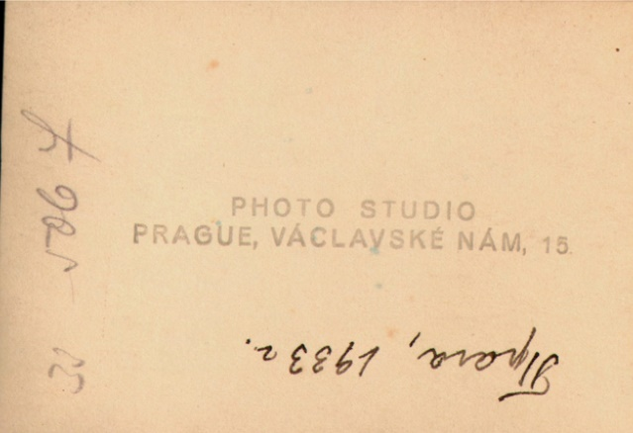
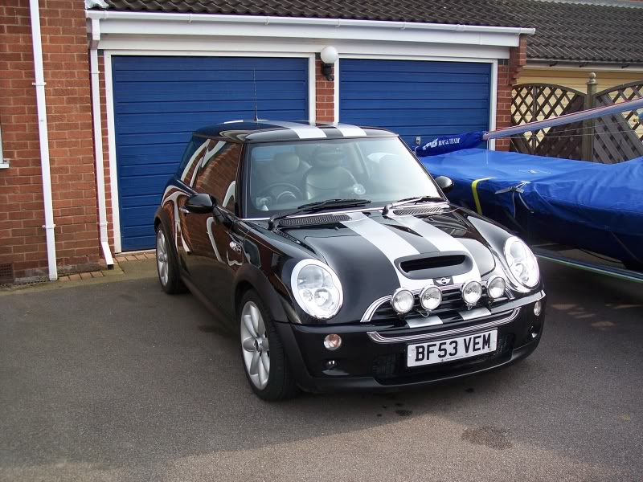
POS and WSD
(n) He wrote the date on the back of the photograph.
(v) Back the car into the driveway.

Slide 5
2 broad categories
Closed class
Open class

Slide 6
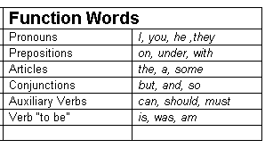
Close Class
Fixed membership (e.g. prepositions, articles)
We don’t introduce new function
words into the language.

Slide 7
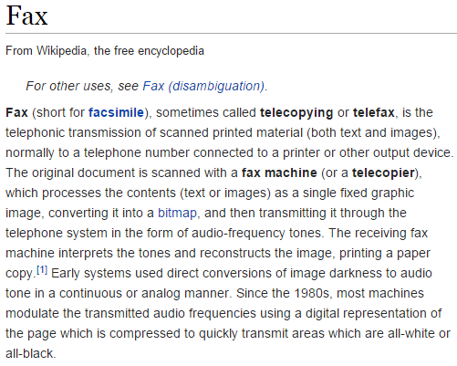

Open Class
always adding (e.g. nouns, verbs)
n. fax: a duplicator that transmits the copy by wire or radio
Over time
v. fax: send something via a fax machine

Slide 8

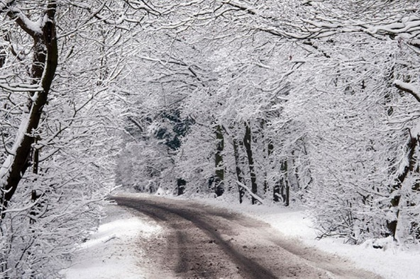
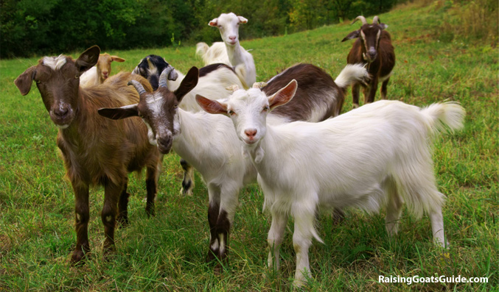
Nouns: person, place or thing
Noun
Proper Noun
Common Noun
Count Noun
Mass Noun
allow grammatical
enumeration
homogenous
group
we don’t talk about three snows
one goat, two goats, three goats, four

Slide 9

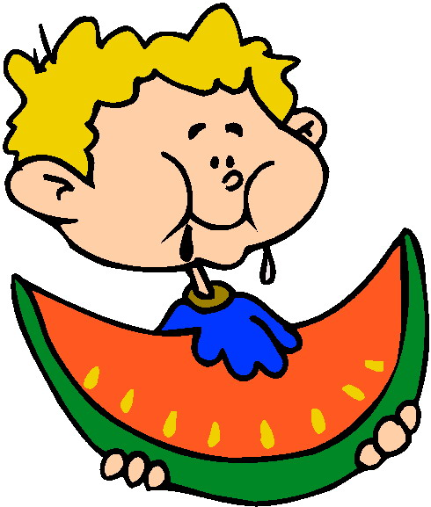
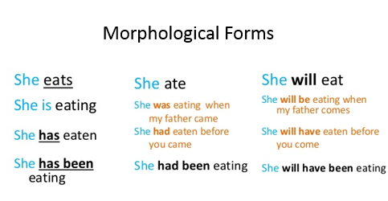
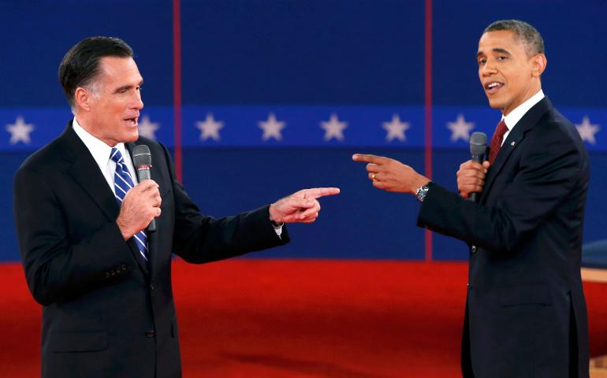
Verbs: actions or processes
To eat
To draw
To debate

Slide 10
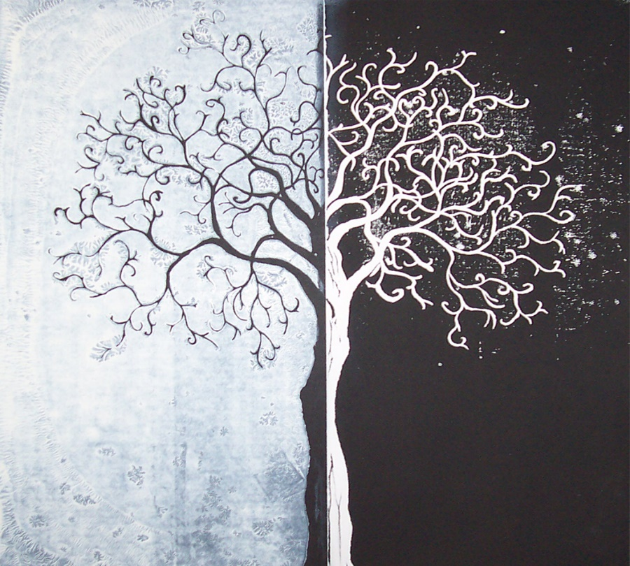
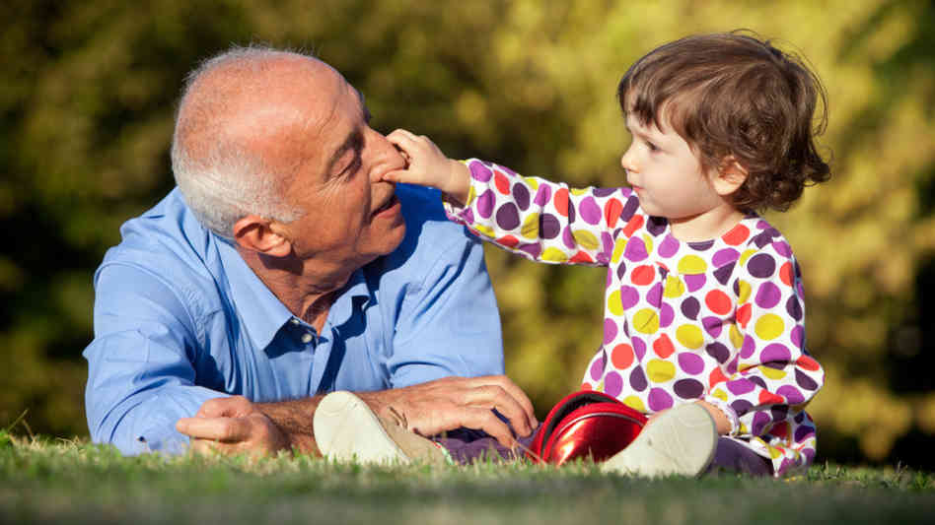

Adjectives: describe properties or qualities
Age: old and young
Color: white and black
Value: good and bad

Slide 11
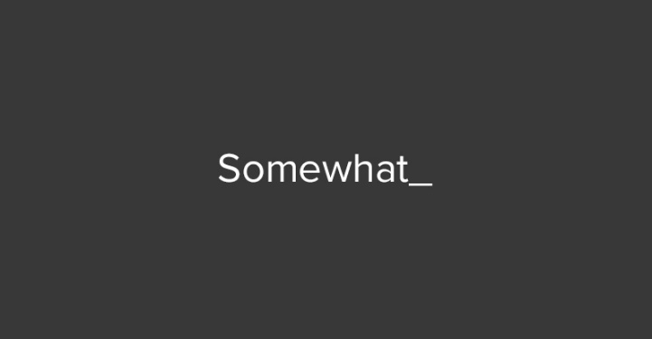
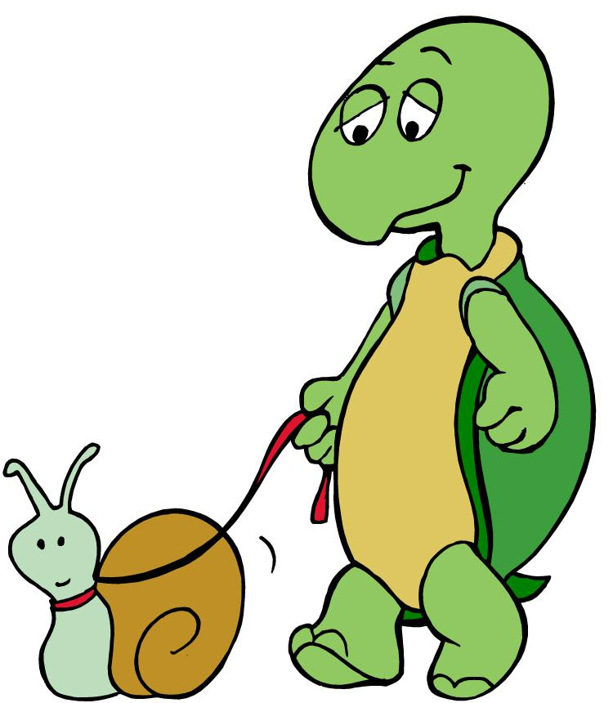
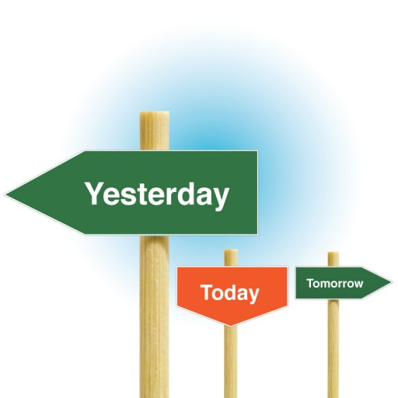

Adverbs: bit of a hodgepodge
Adverbs
Directional
Degree
Manner
Temporal
Home
Here
Downhill
Extremely
Very
Somewhat
Slowly
Delicately
Silkily
Yesterday
Monday
Today

Slide 12
POS Tagging
POS tagging
is the process of assigning a part of speech to each word in a corpus
Book/VB that/DT flight/NN .\.
Does/VBZ that/DT flight/NN serve/VB dinner/NN ?\.

Slide 13
Choosing a Tag set
To do POS tagging, first need to choose a set of tags
Could pick very coarse (small) tagsets
N, V, Adj, Adv.
More commonly used: Brown Corpus (Francis & Kucera ‘82), 1M words, 87 tags – more informative but more difficult to tag
Most commonly used: Penn Treebank: hand-annotated corpus of Wall Street Journal, 1M words, 45-46 subset

Slide 14
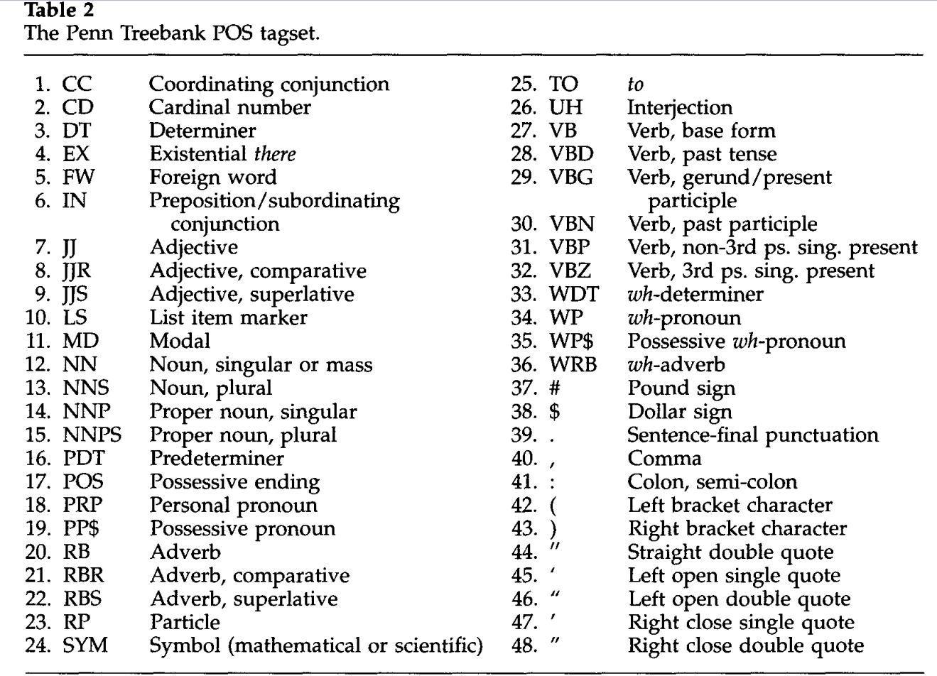

Slide 15
Using the Penn Tree Bank
The/DT grand/JJ jury/NN commented/VBD on/IN a/DT number/NN of/IN other/JJ topics/NNS ./.
Prepositions and subordinating conjunctions marked IN (“although/IN I/PRP..”)
Except the preposition/complementizer “to” is just marked “TO”
NB: PRP$ (possessive pronoun) vs. $

Slide 16
Tagging can be hard for humans and machines
Around can refer to an
RB: adverb IN: preposition RP: particle
Mrs./NNP Shaefer/NNP never/RB got/VBD around/RP to/TO joining/VBG
All/Dt we/PRP gotta/VBN do/VB is/VBZ go/VB around/IN the/DT corner/NN
Chateau/NNP Petrus/NNP costs/VBZ around/RB 250/CD

Slide 17
Tag Ambiguity
Words often have more than one POS: back
The back door = JJ
On my back = NN
Win the voters back = RB
Promised to back the bill = VB
The POS tagging problem is to determine the POS tag for a particular instance of a word

Slide 18
Tagging whole sentences is hard
Ambiguous POS contexts
Time flies like an arrow.
Possible POS assignments
Time/[V,N] flies/[V,N] like/[V,Prep] an/Det arrow/N
Time/N flies/V like/Prep an/Det arrow/N
Time/V flies/N like/Prep an/Det arrow/N
Time/N flies/N like/V an/Det arrow/N
…..

Slide 19
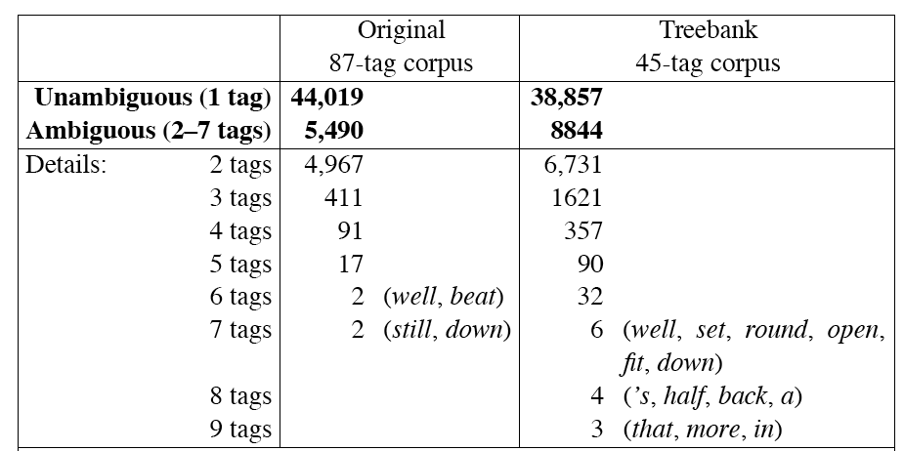
Scale of the Ambiguity Problem

Slide 20
How do we disambiguate?
Many words have only one POS tag (e.g. is, Mary, very, smallest)
Others have a single most likely tag (e.g. a, dog)
Tags also tend to co-occur regularly with other tags (e.g. Det, N)
In addition to conditional probabilities of words P(w₁|w_{n-1}), we can look at POS likelihoods (P(t₁|t_{n-1})) to disambiguate sentences and to assess sentence likelihoods

Slide 21
Two classes of tagging algorithms
Rule based taggers
Use a large database of hand written rules that specify the POS of words
And if a word is ambiguous what POS typically follows the previous POS
Stochastic taggers
Use a training corpus to compute the probability of a given word having
a given tag in a given context

Slide 22
Rule-based POS tagging
Earliest Algorithms had a 2 stage approach:
Stage 1: dictionary to assign each word a list of potential POS tags
Stage 2: list of rules to winnow down the list to a single POS
(Harris, 1962; Klein and Simmons, 1963; Greene and Rubin, 1971)

Slide 23

POS Dictionary
she: PRP
promised: VBN,VBD
to: TO
back: VB, JJ, RB, NN
the: DT
bill: NN, VB
…
for the ~100,000 words of English

Slide 24

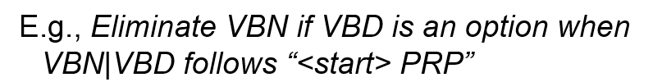
POS Rules

Slide 25
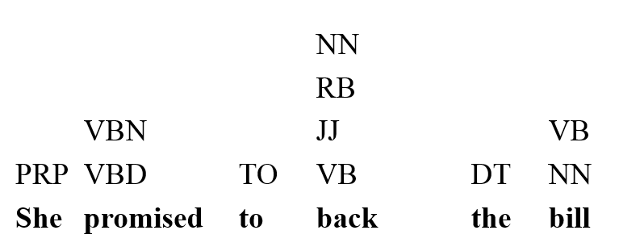
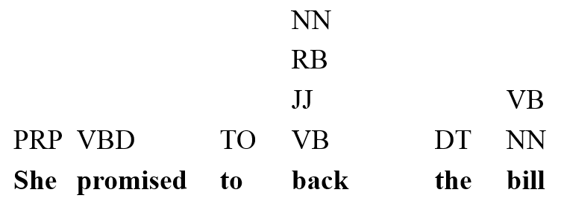
She promised
to back the bill.

Slide 26

She promised
to back the bill.

Slide 27
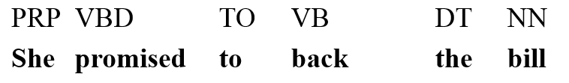
She promised
to back the bill.

Slide 28
Modern rule sets
Similar but have larger set of rules
Example taggers:
EngCG tagger (Voutilainen, 1995, 1999)
Constraing Grammer (Karlsson et al., 1995)

Slide 29
Stochastic POS Tagger
Use probability information found in a training corpus
Use of probabilities in POS Tagging is old:
Stolz, et al. 1965
Bahl and Mercer, 1976
Marshal, 1983
Garside, 1987
Church, 1988
DeRose, 1988

Slide 30

Treat POS tagging as a Classification Task
She
promised
to
back
the
bill
Classification: the goal is to determine which bucket each word is from
NN
NN
VBN
VBD
RB
JJ

Slide 31
Modification: Sequence Classification Task
She
promised
to
back
the
bill
Sequence classification: the best sequence of tags that corresponds to this sequence of words
NN
NN
VBN
VBD
RB
JJ

Slide 32
Modification: Sequence Classification Task
She
promised
to
back
the
bill
So this means that the probability of tag relies on the previous tags
NN
NN
VBN
VBD
RB
JJ

Slide 33

HMM
$${\hat{t}}_{1}^{n}= {argmax}_{t_{1}^{n}} P(t_{1}^{n}|w_{1}^{n})$$
$w_{1}^{n}$ = sequence of n words
$t_{1}^{n}$ = sequence of n tags
${\hat{t}}_{1}^{n}$ =estimate of the correct tag sequence

Slide 34
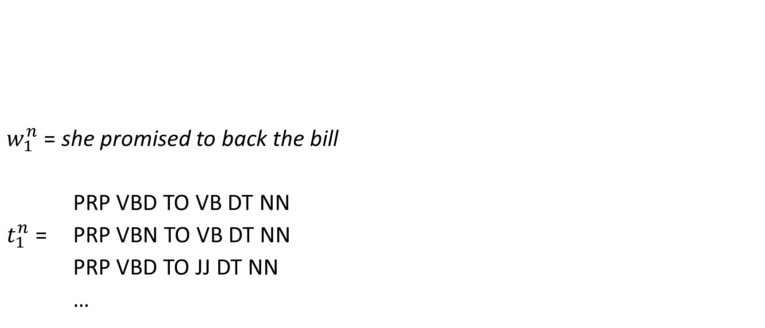

Example
$${\hat{t}}_{1}^{n}= {argmax}_{t_{1}^{n}} P(t_{1}^{n}|w_{1}^{n})$$
$w_{1}^{n}$ = she promised to back the bill
PRP VBD TO VB DT NN
$t_{1}^{n}$ = PRP VBN TO VB DT NN
PRP VBD TO JJ DT NN
…

Slide 35

Example
$${\hat{t}}_{1}^{n}= {argmax}_{t_{1}^{n}} P(t_{1}^{n}|w_{1}^{n})$$
$w_{1}^{n}$ = she promised to back the bill
PRP VBD TO VB DT NN
$t_{1}^{n}$ = PRP VBN TO VB DT NN
PRP VBD TO JJ DT NN
…
the sequence with the largest probability
given “she promised to back the bill”

Slide 36
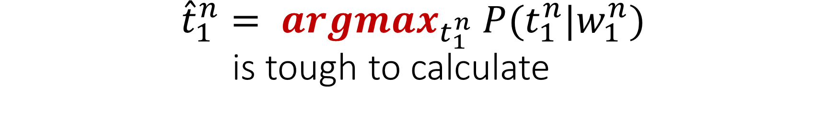
$${\hat{t}}_{1}^{n}= {argmax}_{t_{1}^{n}} P(t_{1}^{n}|w_{1}^{n})$$ is tough to calculate
Why?

Slide 37
$${\hat{t}}_{1}^{n}= {argmax}_{t_{1}^{n}} P(t_{1}^{n}|w_{1}^{n})$$ is tough to calculate
Exactly
The probability of seeing she promised to back the bill
in a corpus is small

Slide 38

Enter Bayes Rule
Bayes Rule allows us to break down any conditional probability
into three components
$$P\left(x | y\right)=\frac{P\left(y | x\right)P(x)}{P(y)}$$

Slide 39
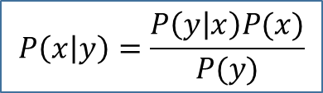

So we can use Bayes Rule
Bayes Rule:
$$P\left(x | y\right)=\frac{P\left(y | x\right)P(x)}{P(y)}$$
To decompose our HMM:
$${\hat{t}}_{1}^{n}= {argmax}_{t_{1}^{n}} P(t_{1}^{n}|w_{1}^{n})$$

Slide 40
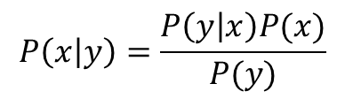

So we can use Bayes Rule
$$P\left(x | y\right)=\frac{P\left(y | x\right)P(x)}{P(y)}$$
To decompose our HMM:
$${\hat{t}}_{1}^{n}= {argmax}_{t_{1}^{n}} P(t_{1}^{n}|w_{1}^{n})$$
$$P\left(t_{1}^{n} | w_{1}^{n}\right)= \frac{P\left(w_{1}^{n} | t_{1}^{n}\right) ∗P(t_{1}^{n})}{P(w_{1}^{n})}$$

Slide 41

So we can use Bayes Rule
$$P\left(x | y\right)=\frac{P\left(y | x\right)P(x)}{P(y)}$$
To decompose our HMM:
$${\hat{t}}_{1}^{n}= {argmax}_{t_{1}^{n}} P(t_{1}^{n}|w_{1}^{n})$$
$${\hat{t}}_{1}^{n}={argmax}_{t_{1}^{n}} \frac{P\left(w_{1}^{n} | t_{1}^{n}\right) ∗P(t_{1}^{n})}{P(w_{1}^{n})}$$

Slide 42
So we can use Bayes Rule
$$P\left(x | y\right)=\frac{P\left(y | x\right)P(x)}{P(y)}$$
To decompose our HMM:
$${\hat{t}}_{1}^{n}= {argmax}_{t_{1}^{n}} P(t_{1}^{n}|w_{1}^{n})$$
$${\hat{t}}_{1}^{n}={argmax}_{t_{1}^{n}} \frac{P\left(w_{1}^{n} | t_{1}^{n}\right) ∗P(t_{1}^{n})}{P(w_{1}^{n})}$$

Slide 43

Now before we go on
We can get rid of our denominator. Why?
$${\hat{t}}_{1}^{n}={argmax}_{t_{1}^{n}} \frac{P\left(w_{1}^{n} | t_{1}^{n}\right) ∗P(t_{1}^{n})}{P(w_{1}^{n})}$$

Slide 44
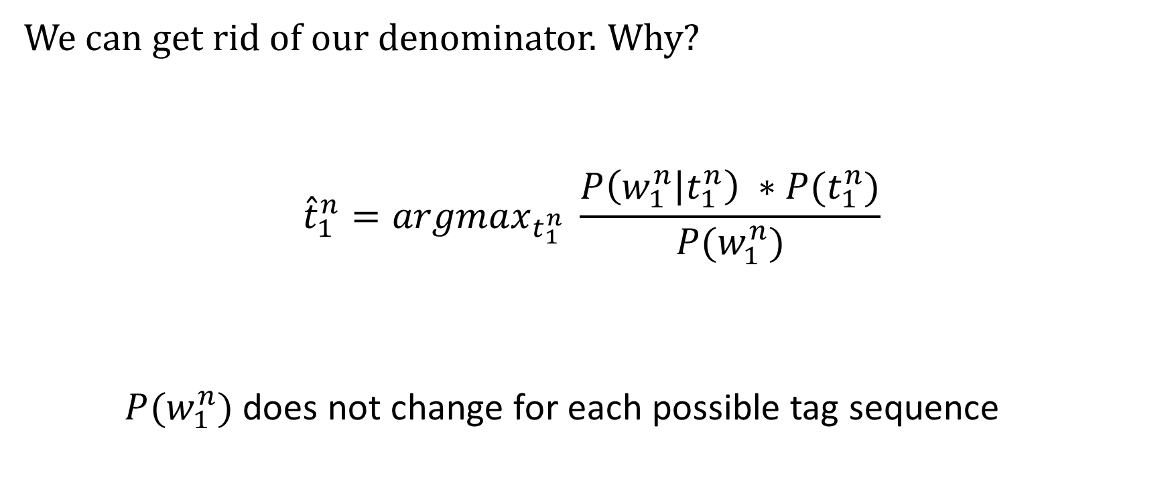
Now before we go on
We can get rid of our denominator. Why?
$${\hat{t}}_{1}^{n}={argmax}_{t_{1}^{n}} \frac{P\left(w_{1}^{n} | t_{1}^{n}\right) ∗P(t_{1}^{n})}{P(w_{1}^{n})}$$
$P(w_{1}^{n})$ does not change for each possible tag sequence

Slide 45

So we can simplify our equation
$${\hat{t}}_{1}^{n}={argmax}_{t_{1}^{n}} P\left(w_{1}^{n} | t_{1}^{n}\right) ∗P(t_{1}^{n})$$

Slide 46
Notation
$${\hat{t}}_{1}^{n}={argmax}_{t_{1}^{n}} P\left(w_{1}^{n} | t_{1}^{n}\right) ∗P(t_{1}^{n})$$
Likelihood
Prior

Slide 47

A recap
$${\hat{t}}_{1}^{n}={argmax}_{t_{1}^{n}} P\left(w_{1}^{n} | t_{1}^{n}\right) ∗P(t_{1}^{n})$$
$w_{1}^{n}$ = she promised to back the bill
PRP VBD TO VB DT NN
$t_{1}^{n}$ = PRP VBN TO VB DT NN
PRP VBD TO JJ DT NN
…
probability of
“she promised to back the bill”
given a tag sequence

Slide 48

A recap
$${\hat{t}}_{1}^{n}≈{argmax}_{t_{1}^{n}} P\left(w_{1}^{n} | t_{1}^{n}\right) ∗P(t_{1}^{n})$$
$w_{1}^{n}$ = she promised to back the bill
PRP VBD TO VB DT NN
$t_{1}^{n}$ = PRP VBN TO VB DT NN
PRP VBD TO JJ DT NN
…
probability of the tag sequence

Slide 49

Let’s look at our likelihood
$$P\left(w_{1}^{n} | t_{1}^{n}\right)$$
Still difficult to calculate: why?

Slide 50

Let’s look at our likelihood
$$P\left(w_{1}^{n} | t_{1}^{n}\right)$$
Still difficult to calculate: why?
The probability of seeing she promised to back the bill
in a corpus is small

Slide 51
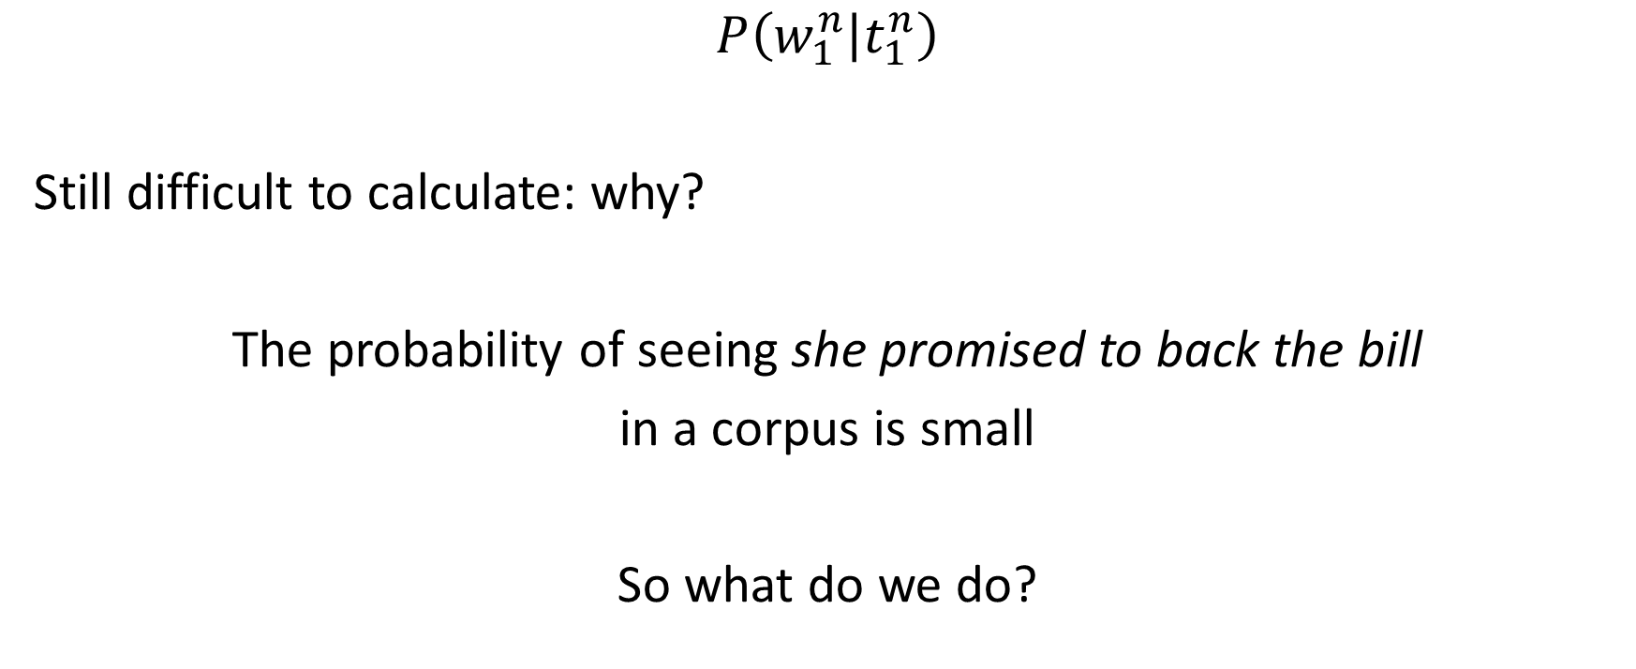
Let’s look at our likelihood
$$P\left(w_{1}^{n} | t_{1}^{n}\right)$$
Still difficult to calculate: why?
The probability of seeing she promised to back the bill
in a corpus is small
So what do we do?

Slide 52
Two Assumptions
Assumption 1
Assumption 2

Slide 53
Assumption 1
the probability of a word appearing depends only on its own POS tag
It is independent of the other words and tags around it

Slide 54
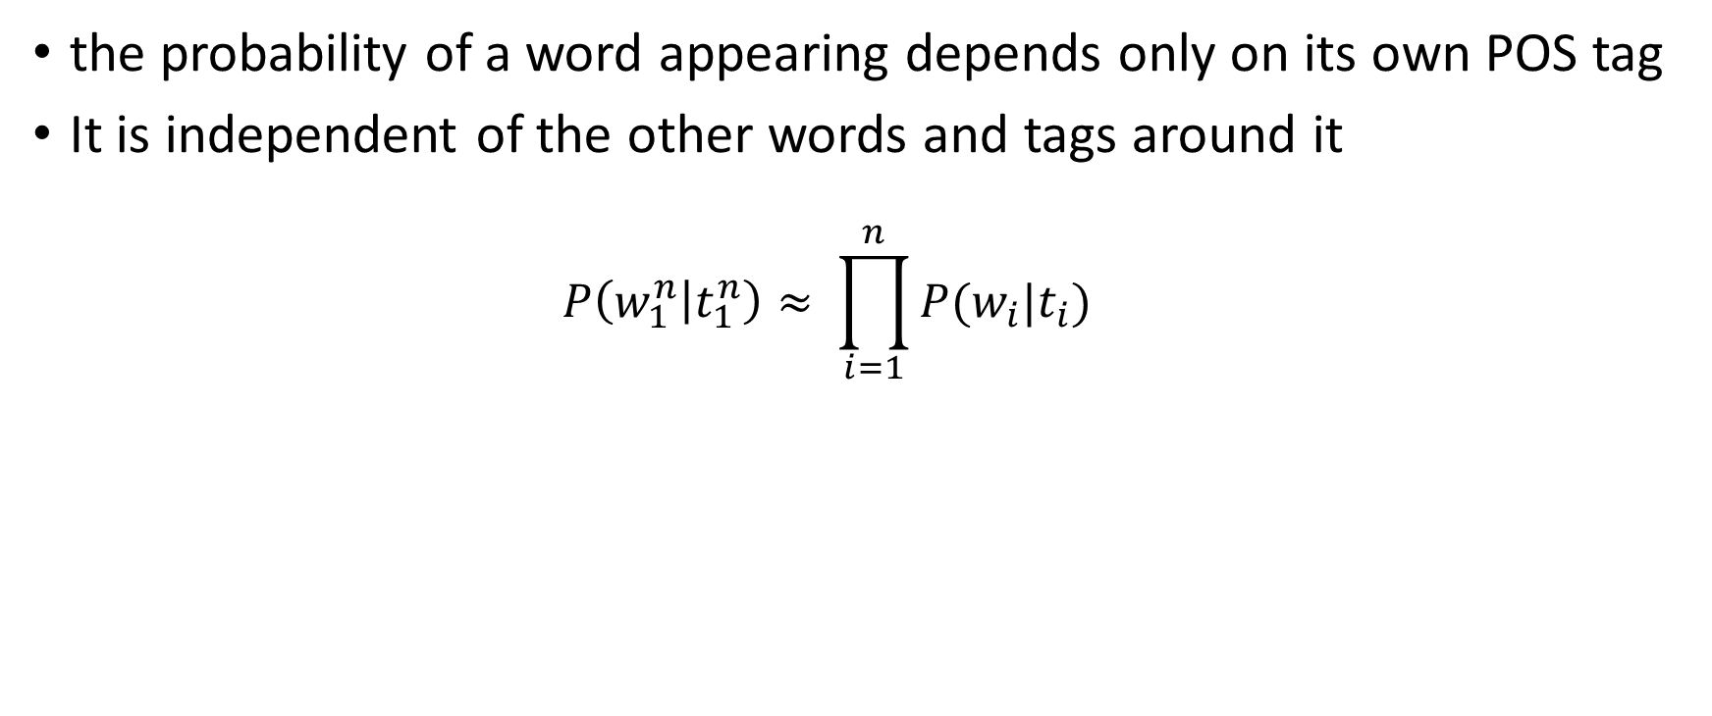
Assumption 1
the probability of a word appearing depends only on its own POS tag
It is independent of the other words and tags around it
$$P\left(w_{1}^{n} | t_{1}^{n}\right)≈ \prod_{i=1}^{n}{P(w_{i}|t_{i})}$$

Slide 55
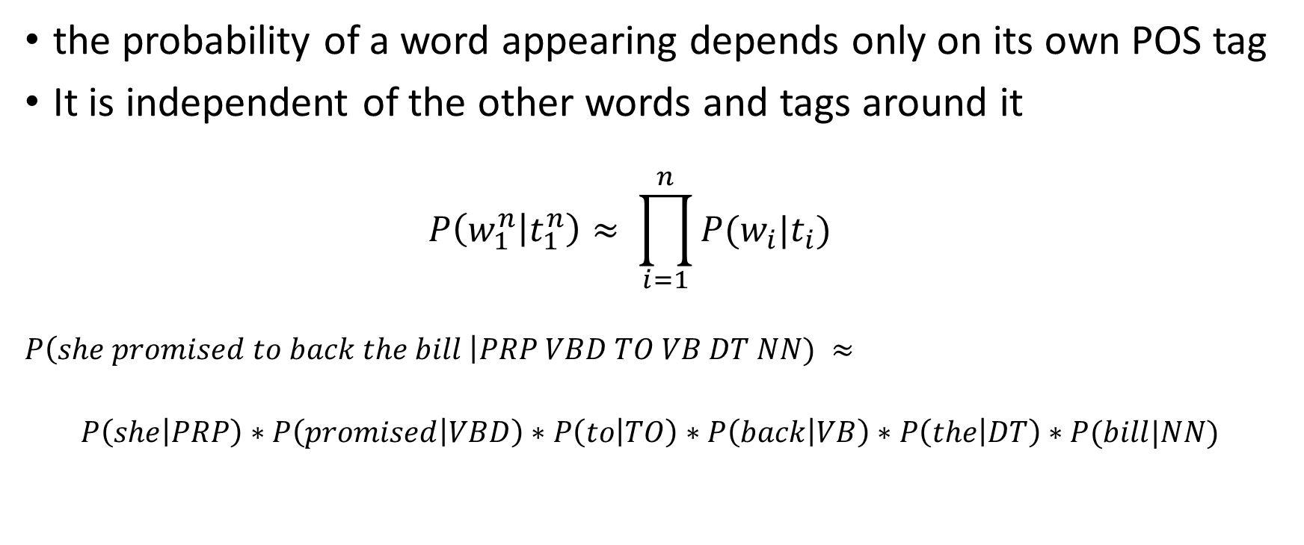
Assumption 1
the probability of a word appearing depends only on its own POS tag
It is independent of the other words and tags around it
$$P\left(w_{1}^{n} | t_{1}^{n}\right)≈ \prod_{i=1}^{n}{P(w_{i}|t_{i})}$$
$$P\left(she promised to back the bill \right|PRP VBD TO VB DT NN) ≈$$
$$P\left(she | PRP\right)∗P\left(promised | VBD\right)∗P\left(to | TO\right)∗P\left(back | VB\right)∗P\left(the | DT\right)∗P(bill|NN)$$

Slide 56

Assumption 1 plugged in
$${\hat{t}}_{1}^{n}={argmax}_{t_{1}^{n}} P\left(w_{1}^{n} | t_{1}^{n}\right) ∗P\left(t_{1}^{n}\right)$$
$≈ {argmax}_{t_{1}^{n}}\prod_{i=1}^{n}{P(w_{i}|t_{i})}∗P(t_{1}^{n})$

Slide 57
Assumption 1 plugged in
$${\hat{t}}_{1}^{n}={argmax}_{t_{1}^{n}} P\left(w_{1}^{n} | t_{1}^{n}\right) ∗P\left(t_{1}^{n}\right)$$
$≈ {argmax}_{t_{1}^{n}}\prod_{i=1}^{n}{P(w_{i}|t_{i})}∗P(t_{1}^{n})$

Slide 58
Assumption 2
the probability of a tag appearing depends only on the previous tag

Slide 59

Remember our Markov assumption
Estimate the conditional probability of the next word without looking too far in the past
$P\left(w_{n} | w_{1}^{n−1}\right) ≈ P\left(w_{n} | w_{n−N+1}^{n−1}\right)$

Slide 60

Assumption 2
the probability of a tag appearing depends only on the previous tag
$$P\left(t_{1}^{n}\right) ≈ \prod_{i=1}^{n}{P(t_{i}|t_{i−1})}$$
What model is this?

Slide 61
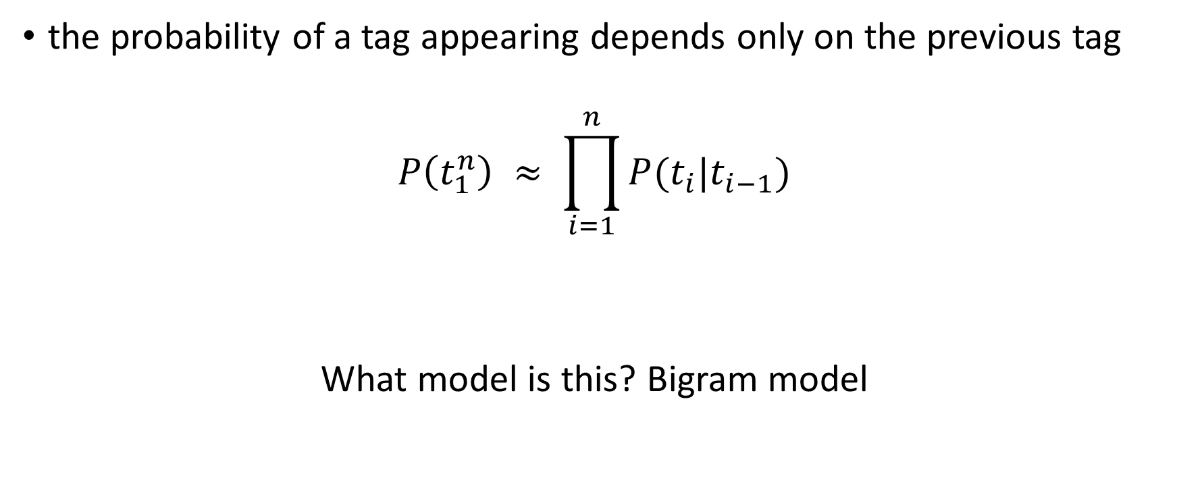
Assumption 2
the probability of a tag appearing depends only on the previous tag
$$P\left(t_{1}^{n}\right) ≈ \prod_{i=1}^{n}{P(t_{i}|t_{i−1})}$$
What model is this? Bigram model

Slide 62

Assumption 2 plugged in
$${\hat{t}}_{1}^{n} ≈ {argmax}_{t_{1}^{n}}\prod_{i=1}^{n}{P(w_{i}|t_{i})}∗P(t_{1}^{n})$$
${≈argmax}_{t_{1}^{n}}\prod_{i=1}^{n}{P(w_{i}|t_{i})}∗P(t_{i}|t_{i−1})$

Slide 63

How do we calculate the individual probabilities
$${\hat{t}}_{1}^{n}{≈argmax}_{t_{1}^{n}}\prod_{i=1}^{n}{P(w_{i}|t_{i})}∗P(t_{i}|t_{i−1})$$
$P(w_{i}|t_{i})$= ?
Remember from your relative frequency tables?

Slide 64

How do we calculate the individual probabilities
$${\hat{t}}_{1}^{n}{≈argmax}_{t_{1}^{n}}\prod_{i=1}^{n}{P(w_{i}|t_{i})}∗P(t_{i}|t_{i−1})$$
$P\left(w_{i} | t_{i}\right)= \frac{frequency(t_{i},w_{i})}{frequency(t_{i})}$

Slide 65

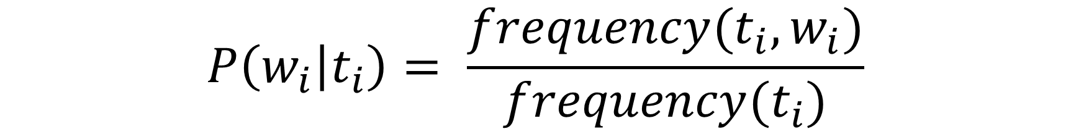
$$P\left(w_{i} | t_{i}\right)= \frac{frequency(t_{i},w_{i})}{frequency(t_{i})}$$
$P\left(promised | VBD\right)=$ ?
 | she | promised | to | back | the | bill
PRP | 58 | 8 | 0 | 0 | 0 | 0
VBN | 2 | 24 | 0 | 1 | 0 | 4
VBD | 2 | 34 | 4 | 1 | 0 | 9
TO | 0 | 0 | 68 | 0 | 1 | 2
NN | 1 | 0 | 0 | 43 | 0 | 82
RB | 1 | 0 | 15 | 0 | 1 | 1
JJ | 2 | 0 | 0 | 32 | 0 | 0
VB | 1 | 10 | 1 | 60 | 0 | 40
DT | 4 | 0 | 3 | 0 | 115 | 0
CORPUS
PRP | VBN | VBD | TO | NN | RB | JJ | VB | DT
2533 | 927 | 2417 | 746 | 158 | 1093 | 341 | 278 | 3000

Slide 66
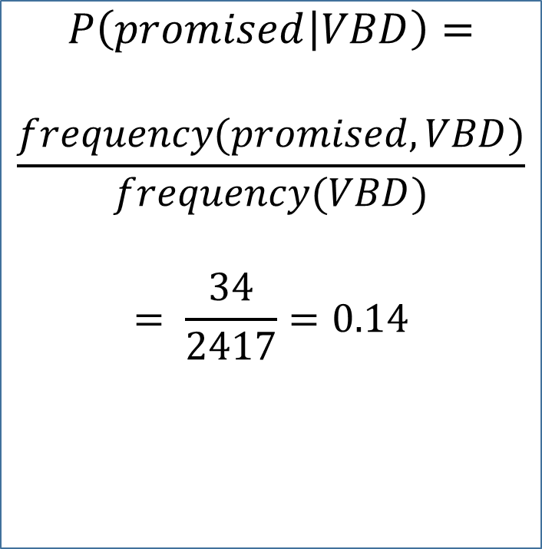
$$P\left(w_{i} | t_{i}\right)= \frac{frequency(t_{i},w_{i})}{frequency(t_{i})}$$
$$P\left(promised | VBD\right)=$$
$$\frac{frequency(promised, VBD)}{frequency(VBD)}$$
$$= \frac{34}{2417}=0.14$$
 | she | promised | to | back | the | bill
PRP | 58 | 8 | 0 | 0 | 0 | 0
VBN | 2 | 24 | 0 | 1 | 0 | 4
VBD | 2 | 34 | 4 | 1 | 0 | 9
TO | 0 | 0 | 68 | 0 | 1 | 2
NN | 1 | 0 | 0 | 43 | 0 | 82
RB | 1 | 0 | 15 | 0 | 1 | 1
JJ | 2 | 0 | 0 | 32 | 0 | 0
VB | 1 | 10 | 1 | 60 | 0 | 40
DT | 4 | 0 | 3 | 0 | 115 | 0
CORPUS
PRP | VBN | VBD | TO | NN | RB | JJ | VB | DT
2533 | 927 | 2417 | 746 | 158 | 1093 | 341 | 278 | 3000

Slide 67

Recap
$${\hat{t}}_{1}^{n}{≈argmax}_{t_{1}^{n}}\prod_{i=1}^{n}{P(w_{i}|t_{i})}∗P(t_{i}|t_{i−1})$$
$P\left(t_{i} | t_{i−1}\right)= \frac{frequency(t_{i−1},t_{i})}{frequency(t_{i−1})}$

Slide 68


$$P\left(t_{i} | t_{i−1}\right)= \frac{frequency(t_{i−1},t_{i})}{frequency(t_{i−1})}$$
$P\left(VBD | PRP\right)=$ ?
 | PRP | VBN | VBD | TO | NN | RB | JJ | VB | DT
PRP | 0 | 30 | 80 | 0 | 0 | 0 | 0 | 0 | 0
VBN | 2 | 0 | 0 | 1 | 0 | 4 | 8 | 14 | 34
VBD | 2 | 34 | 0 | 1 | 0 | 9 | 9 | 9 | 45
TO | 0 | 0 | 68 | 0 | 1 | 2 | 45 | 2 | 28
NN | 1 | 0 | 0 | 43 | 60 | 82 | 8 | 2 | 23
RB | 1 | 0 | 15 | 0 | 1 | 0 | 0 | 0 | 0
JJ | 2 | 0 | 0 | 32 | 0 | 0 | 23 | 0 | 14
VB | 1 | 10 | 1 | 60 | 0 | 40 | 4 | 0 | 12
DT | 14 | 0 | 13 | 0 | 115 | 2 | 14 | 10 | 0
CORPUS
PRP | VBN | VBD | TO | NN | RB | JJ | VB | DT
2533 | 927 | 2417 | 746 | 158 | 1093 | 341 | 278 | 3000

Slide 69

$$P\left(t_{i} | t_{i−1}\right)= \frac{frequency(t_{i−1},t_{i})}{frequency(t_{i−1})}$$
$P\left(VBD | PRP\right)=$
$\frac{frequency(PRP, VBD)}{frequency(PRP)}$
$$= \frac{80}{2533}=0.03$$
 | PRP | VBN | VBD | TO | NN | RB | JJ | VB | DT
PRP | 0 | 30 | 80 | 0 | 0 | 0 | 0 | 0 | 0
VBN | 2 | 0 | 0 | 1 | 0 | 4 | 8 | 14 | 34
VBD | 2 | 34 | 0 | 1 | 0 | 9 | 9 | 9 | 45
TO | 0 | 0 | 68 | 0 | 1 | 2 | 45 | 2 | 28
NN | 1 | 0 | 0 | 43 | 60 | 82 | 8 | 2 | 23
RB | 1 | 0 | 15 | 0 | 1 | 0 | 0 | 0 | 0
JJ | 2 | 0 | 0 | 32 | 0 | 0 | 23 | 0 | 14
VB | 1 | 10 | 1 | 60 | 0 | 40 | 4 | 0 | 12
DT | 14 | 0 | 13 | 0 | 115 | 2 | 14 | 10 | 0
CORPUS
PRP | VBN | VBD | TO | NN | RB | JJ | VB | DT
2533 | 927 | 2417 | 746 | 158 | 1093 | 341 | 278 | 3000

Slide 70

$${\hat{t}}_{1}^{n}= {argmax}_{t_{1}^{n}} P(t_{1}^{n}|w_{1}^{n})$$
$${\hat{t}}_{1}^{n}{≈argmax}_{t_{1}^{n}}\prod_{i=1}^{n}{P(w_{i}|t_{i})}∗P(t_{i}|t_{i−1})$$
We went from here to here in a number of steps
So lets recap…

Slide 71

$${\hat{t}}_{1}^{n}= {argmax}_{t_{1}^{n}} P(t_{1}^{n}|w_{1}^{n})$$

Slide 72

$${\hat{t}}_{1}^{n}= {argmax}_{t_{1}^{n}} P(t_{1}^{n}|w_{1}^{n})$$
$${\hat{t}}_{1}^{n}={argmax}_{t_{1}^{n}} \frac{P\left(w_{1}^{n} | t_{1}^{n}\right) ∗P(t_{1}^{n})}{P(w_{1}^{n})}$$
Bayes Rule

Slide 73

$${\hat{t}}_{1}^{n}= {argmax}_{t_{1}^{n}} P(t_{1}^{n}|w_{1}^{n})$$
$${\hat{t}}_{1}^{n}={argmax}_{t_{1}^{n}} \frac{P\left(w_{1}^{n} | t_{1}^{n}\right) ∗P(t_{1}^{n})}{P(w_{1}^{n})}$$
$${\hat{t}}_{1}^{n}={argmax}_{t_{1}^{n}} P\left(w_{1}^{n} | t_{1}^{n}\right) ∗P(t_{1}^{n})$$
Bayes Rule
Removed denominator
because same over all
calculations – doesn’t
change the outcome

Slide 74

$${\hat{t}}_{1}^{n}= {argmax}_{t_{1}^{n}} P(t_{1}^{n}|w_{1}^{n})$$
$${\hat{t}}_{1}^{n}={argmax}_{t_{1}^{n}} \frac{P\left(w_{1}^{n} | t_{1}^{n}\right) ∗P(t_{1}^{n})}{P(w_{1}^{n})}$$
$${\hat{t}}_{1}^{n}={argmax}_{t_{1}^{n}} P\left(w_{1}^{n} | t_{1}^{n}\right) ∗P(t_{1}^{n})$$
$${\hat{t}}_{1}^{n}≈ {argmax}_{t_{1}^{n}}\prod_{i=1}^{n}{P(w_{i}|t_{i})}∗P(t_{1}^{n})$$
Bayes Rule
Removed denominator
because same over all
calculations – doesn’t
change the outcome
Assumption 1:
words are independent
of their tags

Slide 75

$${\hat{t}}_{1}^{n}= {argmax}_{t_{1}^{n}} P(t_{1}^{n}|w_{1}^{n})$$
$${\hat{t}}_{1}^{n}={argmax}_{t_{1}^{n}} \frac{P\left(w_{1}^{n} | t_{1}^{n}\right) ∗P(t_{1}^{n})}{P(w_{1}^{n})}$$
$${\hat{t}}_{1}^{n}={argmax}_{t_{1}^{n}} P\left(w_{1}^{n} | t_{1}^{n}\right) ∗P(t_{1}^{n})$$
$${\hat{t}}_{1}^{n}≈ {argmax}_{t_{1}^{n}}\prod_{i=1}^{n}{P(w_{i}|t_{i})}∗P(t_{1}^{n})$$
$${\hat{t}}_{1}^{n}{≈argmax}_{t_{1}^{n}}\prod_{i=1}^{n}{P(w_{i}|t_{i})}∗P(t_{i}|t_{i−1})$$
Bayes Rule
Removed denominator
because same over all
calculations – doesn’t
change the outcome
Assumption 1:
words are independent
of their tags
Assumption 2:
Markov assumption
Bigram Model

Slide 76

$${\hat{t}}_{1}^{n}{≈argmax}_{t_{1}^{n}}\prod_{i=1}^{n}{P(w_{i}|t_{i})}∗P(t_{i}|t_{i−1})$$
We have our equation

Slide 77
$${\hat{t}}_{1}^{n}{≈argmax}_{t_{1}^{n}}\prod_{i=1}^{n}{P(w_{i}|t_{i})}∗P(t_{i}|t_{i−1})$$
which we know is just a for loop
over each possible tag sequence
And we are returning the tag
Sequence with the greatest
probability

Slide 78

$${\hat{t}}_{1}^{n}{≈argmax}_{t_{1}^{n}}\prod_{i=1}^{n}{P(w_{i}|t_{i})}∗P(t_{i}|t_{i−1})$$
my $max = 0; my $resultset = “”;
foreach $tagset (sort keys %tagsets) {
my @tags = split/\s+/, $tagset;
my $t = 1;
for my $i (0..$#tags) {
$t *= &getProb1($word[$i],$tags[$i])*
&getProb2($tag[$i-1], $tags[$i]);
}
if($t > $max){
$max = $t;
$resultset = $tagset;
}
}

Slide 79
$${\hat{t}}_{1}^{n}{≈argmax}_{t_{1}^{n}}\prod_{i=1}^{n}{P(w_{i}|t_{i})}∗P(t_{i}|t_{i−1})$$
 | PRP | VBN | VBD | TO | NN | RB | JJ | VB | DT
PRP | 0 | 8 | 0 | 0 | 0 | 0 | 0 | 0 | 0
VBN | 2 | 0 | 0 | 1 | 0 | 4 | 8 | 14 | 34
VBD | 2 | 34 | 0 | 1 | 0 | 9 | 9 | 9 | 45
TO | 0 | 0 | 68 | 0 | 1 | 2 | 45 | 2 | 28
NN | 1 | 0 | 0 | 43 | 60 | 82 | 8 | 2 | 23
RB | 1 | 0 | 15 | 0 | 1 | 0 | 0 | 0 | 0
JJ | 2 | 0 | 0 | 32 | 0 | 0 | 23 | 0 | 14
VB | 1 | 10 | 1 | 60 | 0 | 40 | 4 | 0 | 12
DT | 14 | 0 | 13 | 0 | 115 | 2 | 14 | 10 | 0
 | she | promised | to | back | the | bill
PRP | 58 | 8 | 0 | 0 | 0 | 0
VBN | 2 | 24 | 0 | 1 | 0 | 4
VBD | 2 | 34 | 4 | 1 | 0 | 9
TO | 0 | 0 | 68 | 0 | 1 | 2
NN | 1 | 0 | 0 | 43 | 0 | 82
RB | 1 | 0 | 15 | 0 | 1 | 1
JJ | 2 | 0 | 0 | 32 | 0 | 0
VB | 1 | 10 | 1 | 60 | 0 | 40
DT | 4 | 0 | 3 | 0 | 115 | 0
PRP | VBN | VBD | TO | NN | RB | JJ | VB | DT
2533 | 927 | 2417 | 746 | 158 | 1093 | 341 | 278 | 3000

Slide 80
Programming Assignment #3
POS Tagger (tagger.pl)
Maximizes P(tag|word)
Scoring program (scorer.pl)
Calculates the overall accuracy of the tagger
Calculates the confusion matrix
PA3.zip
pos-train.txt
pos-test.txt
pos-test-key.txt

Slide 81
PA3.zip
pos-train.txt
[ 61/CD years/NNS ]
old/JJ ,/, will/MD join/VB
[ the/DT board/NN ]
as/IN
[ a/DT nonexecutive/JJ director/NN Nov./NNP 29/CD ]
./.
pos-test.txt
No ,
[ it ]
[ was n't Black Monday ]
.
pos-test-key.txt
No/RB ,/,
[ it/PRP ]
[ was/VBD n't/RB Black/NNP Monday/NNP ]
./.

Slide 82
Programs
To run the tagger:
perl tagger.pl pos-train.txt pos-test.txt > pos-test-with-tags.txt
To run the scorer:
Perl scorer.pl pos-test-with-tags.txt pos-test-key.txt > pos-tagging-report.txt

